Slide 1
Annual Business Meeting & Class of 2017 Fellows
May 8, 2017
Arena and Convention Center
Liverpool, United Kingdom

Slide 2
Class of 2017 Fellows
Susan Halabi
Chair, Fellows Committee

Slide 3
The Society for Clinical Trials
2017 Fellows Committee
Chair: Susan Halabi
Gerald Beck Ian Ford
Ivan S. F. Chan Virginia J. Howard
Simon Day Scott Rushing
Marie Diener-West Jay P. Siegel
Dennis O. Dixon

Slide 4
Qualifications for Fellowship
Candidates must have been an SCT member for a total of 10 years, or five of the last 10 years. Each nominee was evaluated by the Committee on the basis of contributions to the advancement of clinical trials in one or more of the following areas:
Methodologic development
Coordination, conduct, or leadership of individual clinical trials
Education
Ethics
Promotion of a better understanding by the general public of the importance of randomized clinical trials
Service to the Society

Slide 5
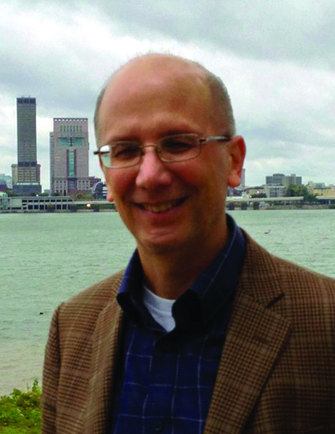
2017 Fellows
Daniel Heitjan, Ph.D.
Southern Methodist University,
Dallas, Texas, USA

Slide 6
The Society for Clinical Trials
2017 Fellows
Daniel Heitjan, PhD: For important contributions to statistical methods in clinical trials, particularly in real-time prediction, the design and analysis
of phase II studies in cancer, economic analysis, and incomplete
data and causal modeling; for leadership in the conduct of clinical
trials; for contributions as a teacher and mentor; and for distinguished
and sustained editorial service.

Slide 7
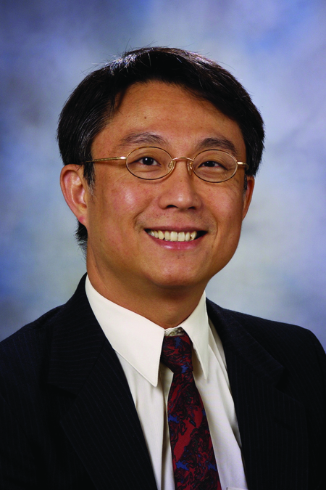
2017 Fellows
J. Jack Lee, Ph.D.
M.D. Anderson Cancer Center
Houston, TX, USA

Slide 8
The Society for Clinical Trials
2017 Fellows
J. Jack Lee, PhD: For seminal contribution to the development of Bayesian adaptive designs; for deriving innovative statistical methods in translational research; for leadership in the design and implementation of novel treatment and prevention trials in cancer; for dedicated education effort in developing software and organizing clinical trial method workshops; for training and mentoring the next generation clinical trial biostatisticians; and for service to the Society.

Slide 9
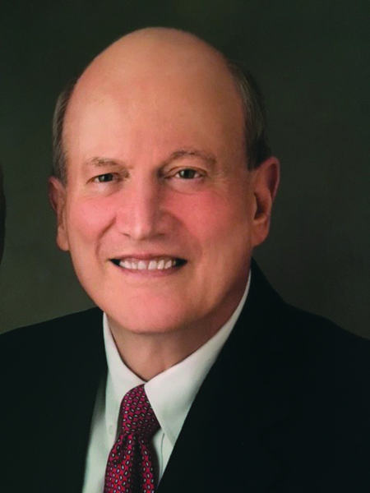
2017 Fellows
Kerry Lee, Ph.D.
Duke University School of Medicine
Durham, NC, USA

Slide 10
The Society for Clinical Trials
2017 Fellows
Kerry Lee, PhD: For excellence in leading the statistical and data coordinating center for large multicenter clinical trials, including many important pivotal trials in cardiovascular disease; for excellence in teaching, mentoring, and advocating rigorous design, conduct, and analysis of clinical trials; for providing important clinical trials leadership at the Duke Clinical Research Institute; and for national leadership on NIH clinical trial review committees and active participation on many DSMBs.

Slide 11
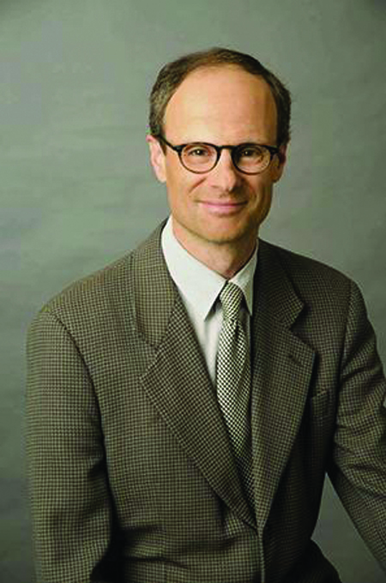
2017 Fellows
Yves Rosenberg, M.D. M.P.H.
National Heart, Lung and Blood Institute
Bethesda, MD, USA

Slide 12
The Society for Clinical Trials
2017 Fellows
Yves Rosenberg, M.D, M.P.H.: For his contributions to the design, management, oversight and reporting of more than a dozen major, large, complex, multicenter international cardiovascular clinical trials supported by the National Heart, Lung, and Blood Institute, the results of which have been incorporated in clinical guidelines and are influencing today’s practice of cardiovascular medicine in the United States and all over the world.

Slide 13
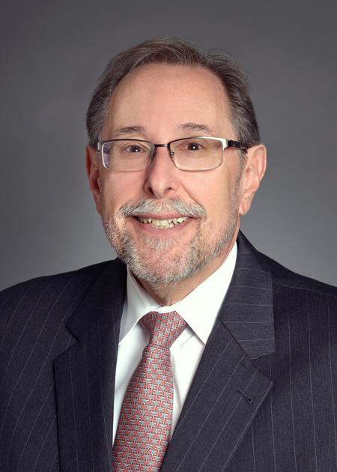
2017 Fellows
Richard L. Schilsky, M.D.
Senior Vice President and Chief Medical Officer
American Society of Clinical Oncology
Alexandria, VA, USA

Slide 14
The Society for Clinical Trials
2017 Fellows
Richard L. Schilsky, M.D.: For exemplary leadership in the conduct of multi-center cancer clinical trials sponsored by the National Cancer Institute primarily through the Cancer and Leukemia Group B; for outstanding contributions to regulatory science and policy in support of efficient clinical trials through participation in numerous NCI and FDA advisory committees and policy boards; and for dedicated participation in clinical research training programs developed by the American Society of Clinical Oncology, the Cancer Education Consortium and the University of Chicago.

Slide 15
Class of 2017 Fellows Congratulations!

